Slide 1
Users and Groups

Slide 2
Users and Groups
Two primary users on Unix/Linux systems: root vs. non-root
Each user is assigned a unique ID (uid)
uid = 0 is reserved for root (super user)
Users need to login with their password
User information is stored in /etc/passwd
/etc/passwd used to contain the password, but has now been moved to a different file
Example: john:x:30000:40000:John Doe:/ home/john:/bin/bash
uid
gid
gecos
shell
Password
Home dir
username

Slide 3
Users and Groups
The encrypted password is stored in /etc/shadow
john:$6$Etg2ExUZ$F9NTP7omafhKIlqaBMqng1:15651:0:99999:7: : :
1 2 3 4 5 6 7 8 9
The fields are as follow:
1: username
2: encoded password
3: days since the UNIX time that the password was changed
4: minimum number of days before password can be changed (0 means allow password changes anytime)
5: maximum number of days the password is valid (99999 means user can keep their password unchanged forever)
6: number of days before user is warned about password expiration
7: number of days after password expires that the account is disabled (inactive)
8: days since the UNIX time the account is disabled (expiration)
9: reserved field

Slide 4
Users and Groups
The password field is further broken down into the subfields (notice $ in :$6$Etg2ExUZ$F9NTP7omafhKIlqaBMqng1:)
6: is the ID of the algorithm, in this case SHA512 hashing algorithm
Etg2ExUZ: is a salt
F9NTP7omafhKIlqaBMqng1: is the hash(salt + password)
Why do we do this?

Slide 5
Users and Groups
Sometimes it is convenient to assign permissions to a group of users for accessing common resources
A user can be a member of multiple groups
Group member information is stored in /etc/group
# groups uid (will display the groups a given uid belongs to)

Slide 6
File Permissions
Permissions on files:
3 attributes (bits) are used to describe permissions
Owner(u), Group(g), and Others(o)
Readable(r), Writable(w), and Executable(x)
Example: -rwxrwxrwx which is equivalent to 777
Permissions on directories:
Why does 644 mean?
r: the directory can be listed
w: can create/delete a file or directory within the directory
x: the directory can be entered
chmod is used to change permissions
Default file permission:
The default file permission assigned to a user is controlled through the umask environment variable
umask contains bits set for the permissions you don’t want to provide
Example: umask 077 will set the permission for newly created files to rwx------ (non-execultable)

Slide 7
Security Related Commands
Change your user ID to xyz with su (substitute user)
su xyz
To change your user to root you run the command below. Once root, you get # as a prompt
su -
Running a command using superuser privilege without logging in as root is useful. We can use
sudo for that
Example: to view the shadow file as a superuser
sudo more /etc/shadow
To be able to use sudo, the superuser (root) must grant permission to the user by adding them to the list of
sudoers (/etc/sudoers)
To change ownership of a file, use chown
chown john filename

Slide 8
Privilege Escalation

Slide 9
Set-uid
How can a user run passwd the command to change their password, but can’t access the /etc/shadow file?

Slide 10
Set-uid
How can a user run passwd the command to change their password, but can’t access the /etc/shadow file?
Each process has a real uid (ruid) and an effective uid (euid)
When a user logs in, the effective uid is the same as the real uid
The effective uid can change temporarily to allow privileged access to resources
Without this ability most programs would be useless
In addition to rwx attributes, each executable file has a set-uid bit
If the set-uid bit is set on a program, the euid will be set to the owner id when entering the executable
euid is set back to the ruid after returning from the executable
Notes:
pid = process ID
Effective user id can change temporarily to allow privileged access to resources
If processes could not get temporary privileged access, most programs would be useless
For privileged (set-uid program executable) you will see for example rws instead of rwx, where s means privileged and execution privileges.

Slide 11
Set-UID Privileged Programs

Slide 12
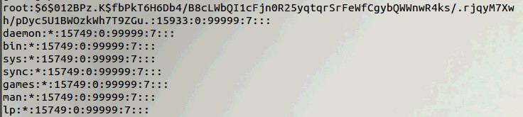
Need for Privileged Programs
Password Dilemma
Permissions of /etc/shadow File:
How would normal users change their password?

Slide 13
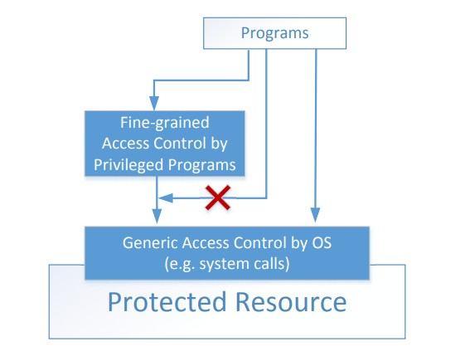
Two-Tier Approach
Implementing fine-grained access control in operating systems make OS over complicated.
OS relies on extension to enforce fine- grained access control
Privileged programs are such extensions

Slide 14
Types of Privileged Programs
Daemons
Computer program that runs in the background
Needs to run as root or other privileged users
Set-UID Programs
Widely used in UNIX systems
Program marked with a special bit

Slide 15

Superman Story
Power Suit
Superpeople: Directly give them the power
Issues: bad superpeople
Power Suit 2.0
Computer chip (replaced people)
Specific task
No way to deviate from pre-programmed task
Set-UID mechanism: A Power Suit (2.0) mechanism implemented in Linux OS

Slide 16
Set-UID Concept
Allow user to run a program with the program owner’s privilege.
Allow users to run programs with temporary elevated privileges
Example: the passwd program
$ ls -l /usr/bin/passwd
-rwsr-xr-x 1 root root 41284 Sep 12 2012 /usr/bin/passwd
Notes:
In this example, lets say ruid =1000 and euid = ruid.
Root has uid of 0
So when passwd program runs, the euid becomes 0 for the user trying to run the passwd program so that they can have temporary privileged execution access of the /etc/shadow file that passwd program accesses.
So, the OS basis access control of a user is based off euid
When program finishes running, then euid becomes 1000 again (same as ruid)
NOTE: if groups and/or others have x bit set to true, and owner has s bit set, then users and groups will have s-level execute privileges as well.

Slide 17
Set-UID Concept
Every process has two User IDs.
Real UID (RUID): Identifies real owner of process
Effective UID (EUID): Identifies privilege of a process
Access control is based on EUID
When a normal program is executed, RUID = EUID, they both equal to the ID of the user who runs the program
When a Set-UID is executed, RUID ≠ EUID. RUID still equal to the user’s ID, but EUID equals to the program owner’s ID.
If the program is owned by root, the program runs with the root privilege.

Slide 18
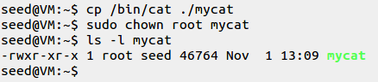
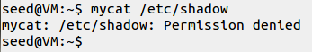
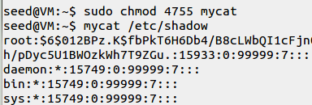
Turn a Program into Set-UID
Change the owner of a file to root :
Before Enabling Set-UID bit:
After Enabling the Set-UID bit :
Notes:
Remember: sudo → raises privileges → run a program as root (euid = 0)
Above line: sudo chmod 4755 mycat → 4 means make it a set euid = owner uid bit (s) for execute bit of owner, 7 = rws, 5 = r-x, 5 = r-x
Note: mycat file owned by root, thus seed is a part of the others group of the file permissions.
Also note: mycat is ran by seed (id = 1000) as group (not as owner, since owner is root!), then mycat program takes on seed’s id, and tries to access /etc/shadow, and the shadow file is owned by root and thus mycat (ran by seed) needs to raise privelges → euid = 0 (root) in order to access that shadow file.
NOTE: If a user is part of a group, but the permissions for a file for groups is not set to true, but others is, then that user will still be able to have privileges to the file; so all users are a part of the others group, thus even if group that a user is part of does not have privileges, that user (like all users) are by default a part of others group.

Slide 19
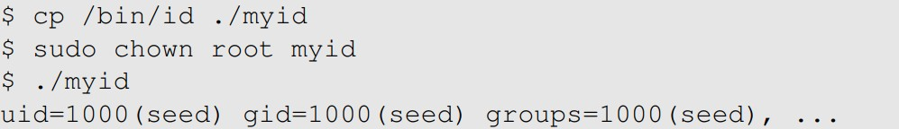
How it Works
A Set-UID program is just like any other program, except that it has a special marking, which a single bit called Set-UID bit

Slide 20
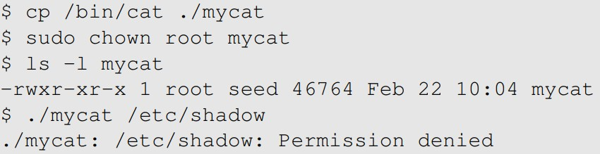

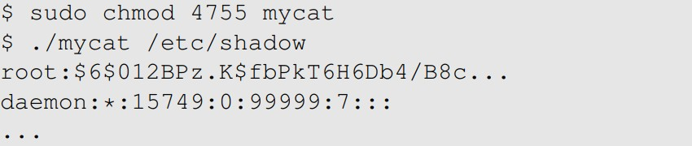
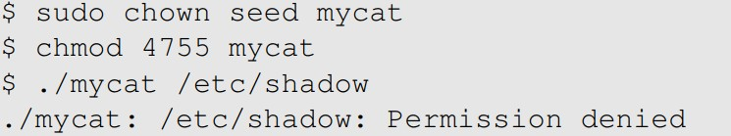
Example of Set UID
Not a privileged program
Become a privileged program
It is still a privileged program, but not the root privilege (s bit from 4 makes euid change to seed’s (owner) id)
Notes:
Special note: when root is the user, OS will check ruid before euid; thus if ruid = 0, it will automatically skip checking euid and give root all privileges.

Slide 21
How to get access to an account later in 10 seconds
Copy: /bin/tmp directory file to tmp_copy
To: another global directory that all users can see on the machine, for example /bin/tmp_copy
Then: set permissions of the tmp_copy file to chmod 4777
Make it a set UID and give all users (user, group, other) to have all permissions.
Now when program runs it has root privileges (gives temp root id to any user that runs the program)

Slide 22
How is Set-UID Secure?
Allows normal users to escalate privileges
This is different from directly giving the privilege (sudo command)
Restricted behavior – similar to superman designed computer chips
Unsafe to turn all programs into Set-UID
Example: /bin/sh
Example: vi
Notes:
Vi editor allows you to type in command line commands right inside of the editor; thus if you make vi editor a set UID program, then it is as bad as allowing /bin/sh program to be a set UID program; you might as well let all users be a sudoer at that point.
Remember, set UID programs only allows users who have execution access to temporarily have escalated privileges (a temp UID set to be the same as of the owner of the file) within the confines of that program
But sudo accounts have escalated privileges for any file that is owned/a part of the sudoer account you are a part of; so it is much less restricted, if at all.

Slide 23

Attack on Superman
Cannot assume that user can only do whatever is coded
Coding flaws by developers
Superperson Mallroy
Fly north then turn left
How to exploit this code?
1
2
Superperson Malorie
Fly North and turn West
How to exploit this code?
Superperson is supposed to take path 1, but they take path 2

Slide 24
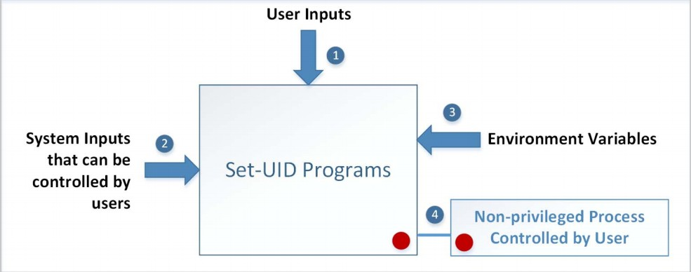
Attack Surfaces of Set-UID Programs

Slide 25
Attacks via User Inputs
User Inputs: Explicit Inputs
Buffer Overflow – More information in Chapter 4
Overflowing a buffer to run malicious code
Format String Vulnerability – More information in Chapter 6
Changing program behavior using user inputs as format strings

Slide 26
Attacks via User Inputs
CHSH – Change Shell
Set-UID program with ability to change default shell programs
Shell programs are stored in /etc/passwd file
Issues
Failing to sanitize user inputs
Attackers could create a new root account
Attack
Notes:
We can add additional input to the CHSH (change shell program) so that it writes another line inside of the etc/passwd file for example that adds an account with root for example.

Slide 27
Attacks via System Inputs
System Inputs
Race Condition – More information in Chapter 7
Symbolic link to privileged file from a unprivileged file
Influence programs
Writing inside world writable folder

Slide 28
Attacks via Environment Variables
Behavior can be influenced by inputs that are not visible inside a program (i.e. environment variables, aka variables in a program that point to files with values that set variables of a program that consumes that file with those values).
Environment Variables : These can be set by a user before running a program.
Detailed discussions on environment variables will be in Chapter 2.

Slide 29
Attacks via Environment Variables
What are environment variables?
Variables of a program that point to another file for input.
What is the PATH environment variable? (an env var used by Bash)
if you do not proceed a command with / in a shell, then it will by default search the current directory, then second it will pass in PATH and search that directory for the command. This is why commands such as ‘ls’ command works when you are in any directory in a shell.
How can System(“Is”) be exploited?

Slide 30
Attacks via Environment Variables
PATH Environment Variable
Used by shell programs to locate a command if the user does not provide the full path for the command
system(): call /bin/sh first
system(“ls”)
/bin/sh uses the PATH environment variable to locate “ls”
Attacker can manipulate the PATH variable and control how the “ls” command is found
More examples on this type of attacks can be found in Chapter 2

Slide 31
Capability Leaking
In some cases, Privileged programs downgrade themselves during execution
Example: The su program (switch user program)
This is a privileged Set-UID program
Allows one user to switch to another user ( say user1 to user2 )
Program starts with EUID as root and RUID as user1
After password verification, both EUID and RUID become user2’s (via privilege downgrading)
Such programs may lead to capability leaking
Programs may not clean up privileged capabilities before downgrading

Slide 32
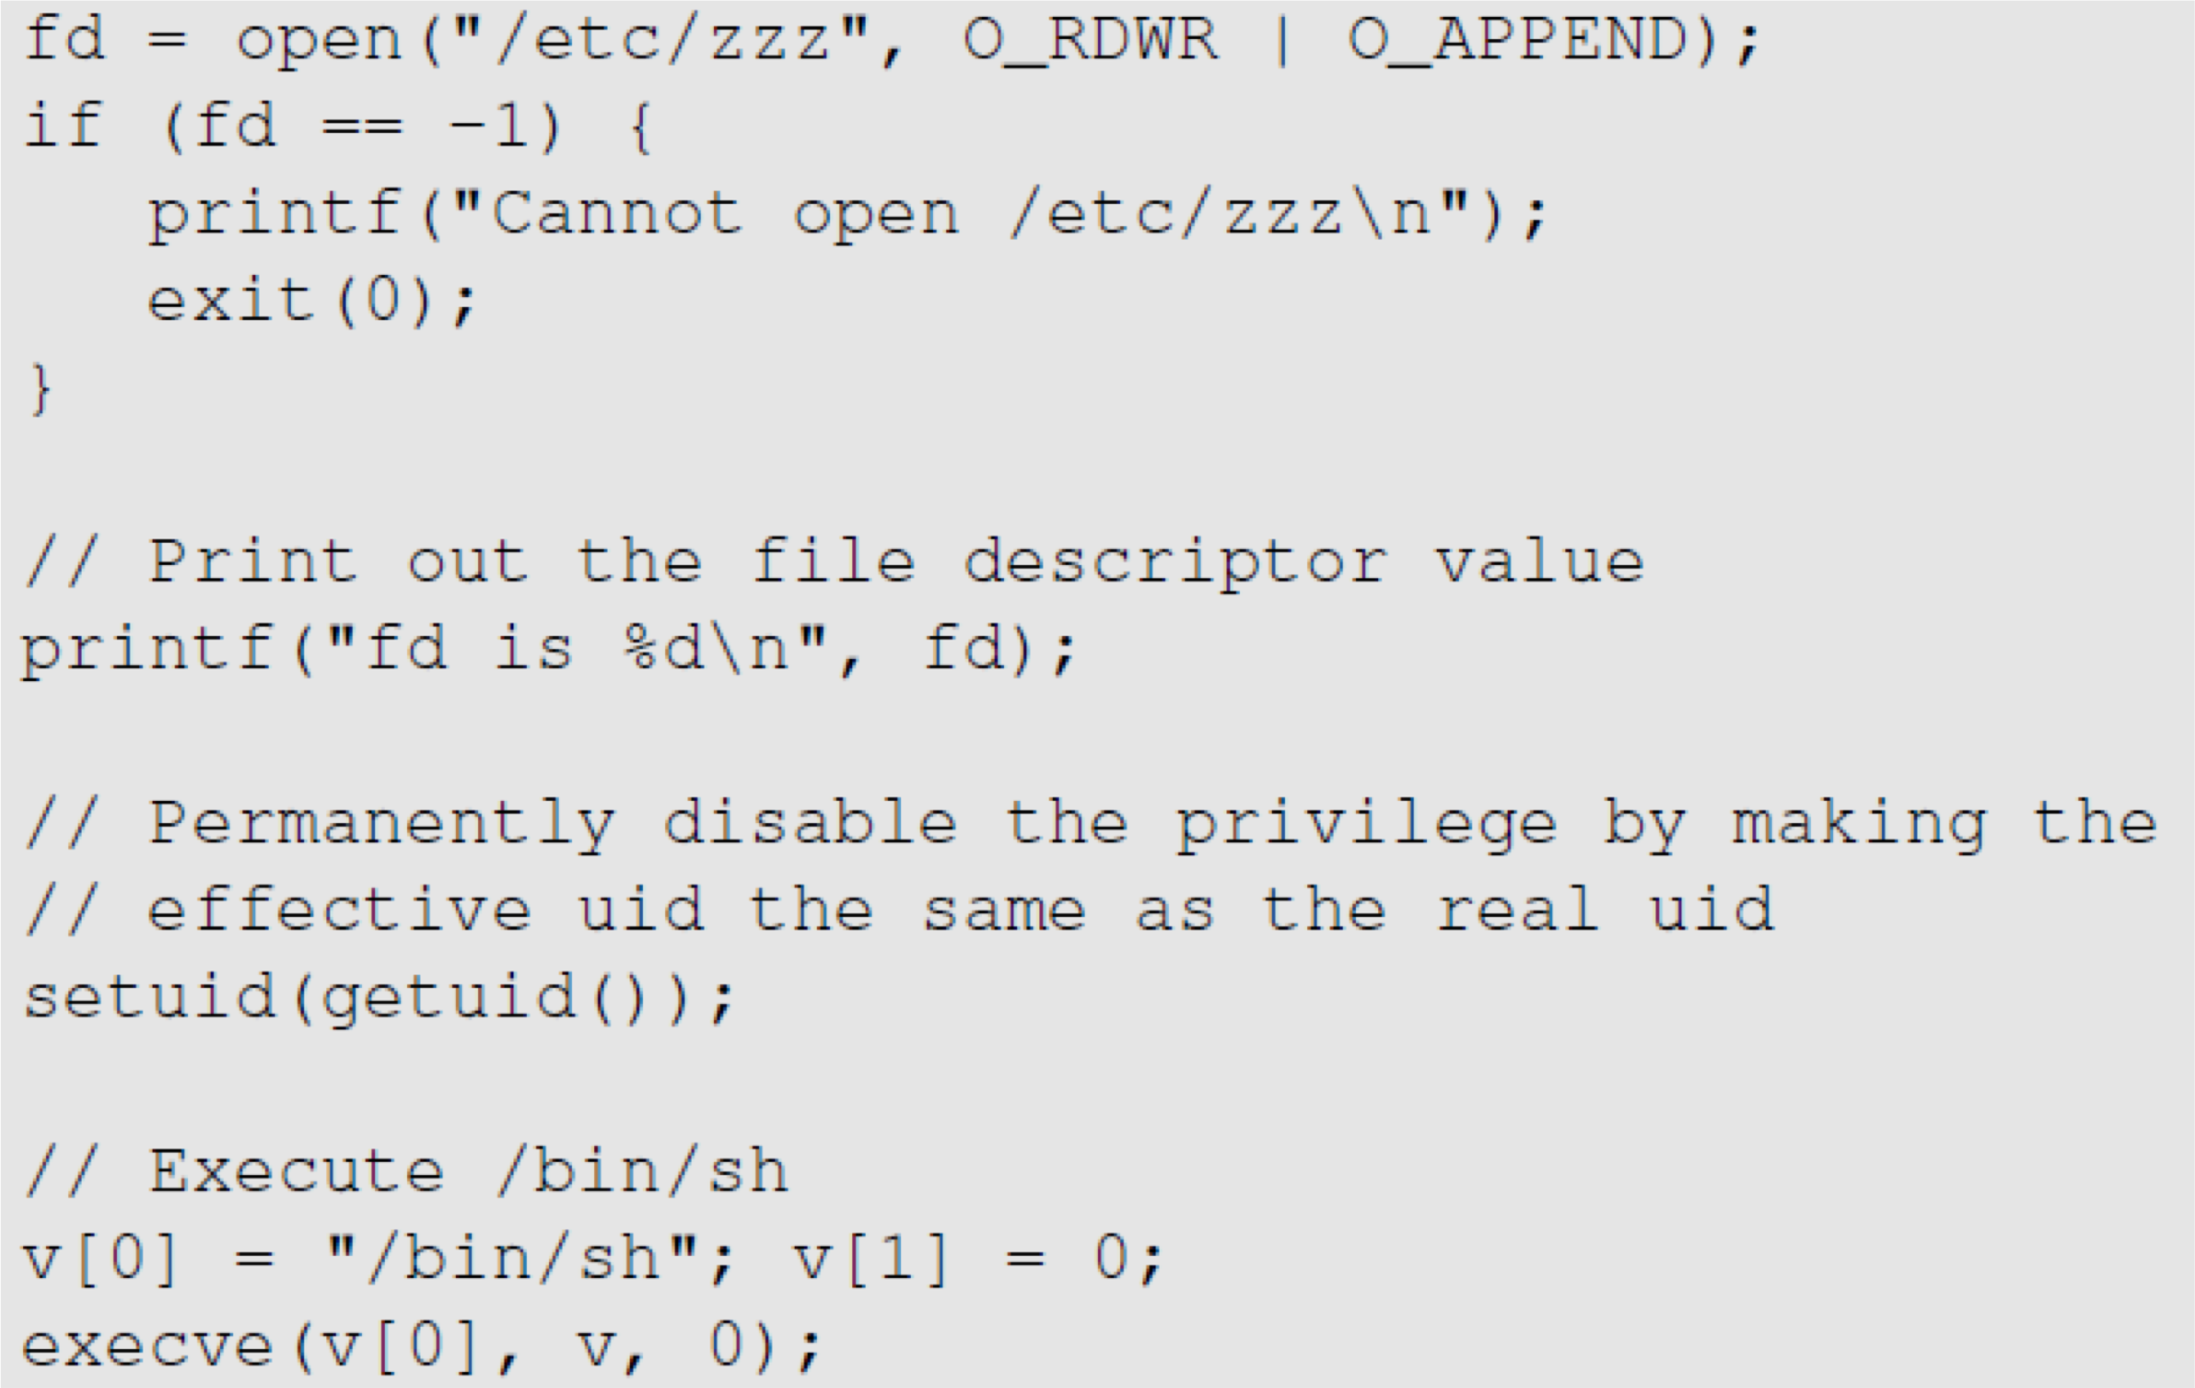
Attacks via Capability Leaking: An Example
The /etc/zzz file is only writable by root
File descriptor is created (the program is a root- owned Set-UID program)
The privilege is downgraded
Invoke a shell program, so the behavior restriction on the program is lifted
Notes:
Above is a set UID program owned by ROOT
fd = file descriptor (number used and stored in fd table to keep track of that file stream)
Setuid() program by default will set both the RUID and EUID = the parameter passed to it.
Execve will execute whatever program is passed to it
Remember execve program from CIS-450 OS how it can be used to invoke another process.

Slide 33
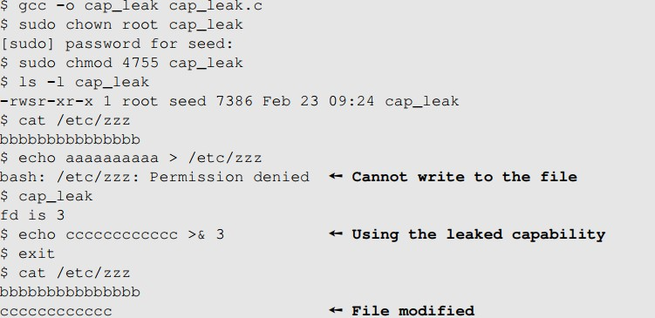
Attacks via Capability Leaking (Continued)
The program forgets to close the file, so the file descriptor is still valid.
Capability Leak
How to fix the program?
Destroy the file descriptor before downgrading the privilege (close the file)
Notes:
Remember with >, it will redirect output to start of the file you redirect to (or create file if it does not exist); the >> redirect operator will APPEND the redirected output to end of a file.
>&3 is sending (redirecting) output to reference (file descriptor) &3.
Note, fd was opened in append mode (see previous slide), so when you used >&3, it appended cccccccc…. To the zzz file.
How to fix above problem: don’t forget to close files! (see last slide, file was never closed!)
OS will garbage collect often and close file eventually, but now we have a RACE CONDITION where another executable will try to write to file before OS cleans it up and closes it.

Slide 34
Capability Leaking in OS X – Case Study
OS X Yosemite found vulnerable to privilege escalation attack related to capability leaking in July 2015 ( OS X 10.10 )
Added features to dynamic linker dyld
DYLD_PRINT_TO_FILE environment variable
The dynamic linker can open any file, so for root-owned Set-UID programs, it runs with root privileges. The dynamic linker dyld, does not close the file. There is a capability leaking.
Scenario 1 (safe): Set-UID finished its job and the process dies. Everything is cleaned up and it is safe.
Scenario 2 (unsafe): Similar to the “su” program, the privileged program downgrade its privilege, and lift the restriction.

Slide 35
Invoking Programs
Invoking external commands from inside a program
External command is chosen by the Set-UID program
Users are not supposed to provide the command (or it is not secure)
Attack:
Users are often asked to provide input data to the command.
If the command is not invoked properly, user’s input data may be turned into command name. This is dangerous.
Notes:
Idea is that you want to call other programs from your program (libraries, other processes…etc.), so you do not have to reinvent the wheel and take advantage of value added from other programs.
Problem: need to be careful with setUID programs that you call in your program.

Slide 36
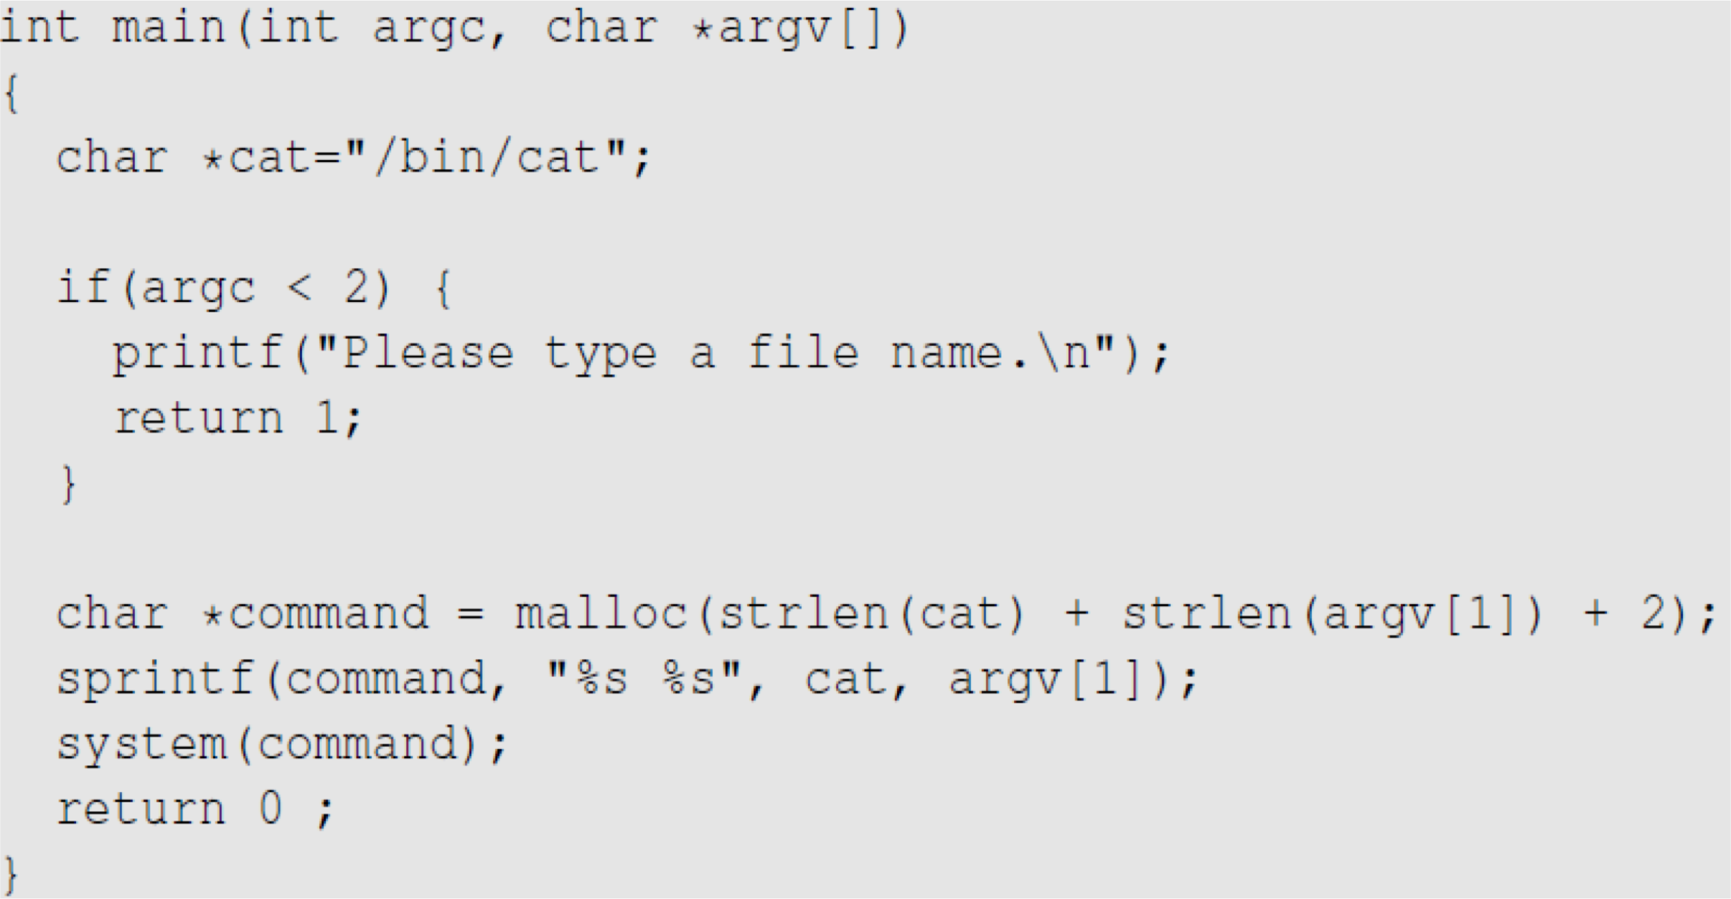
Invoking Programs : Unsafe Approach
The easiest way to invoke an external command is the system() function.
This program is supposed to run the /bin/cat program.
It is a root-owned Set-UID program, so the program can view all files, but it can’t write to any file.
Question: Can you use this program to run other command, with the root privilege?
Notes:
Remember argc gives program count (default first argument is program name)
Argv is the argument vector, which gives values for the argument a user passed in (again, default first string is program name, including path)
The +2 is because “string_val” has implicit null terminator → c and c++ strings have implicit null terminators in order to be a standard string.
Thus 2 string arguments = need 2 bytes for 2 null terminatory characters
sprintf stands for "string print". In C programming language, it is a file handling function that is used to send formatted output to the string. Instead of printing on console, sprintf() function stores the output on char buffer that is specified in sprintf.
System(command) = a way of invoking external programs → fires up a shell program and runs command in the shell.
How to exploit above program: input a string with ‘;’ character! So that you can pass in a string that will lead to command having multiple commands to run (a script).
You can use a ‘;’ to string together multiple commands in Linux! (similar to c++), the ; denotes end of a command and start of the next one.

Slide 37
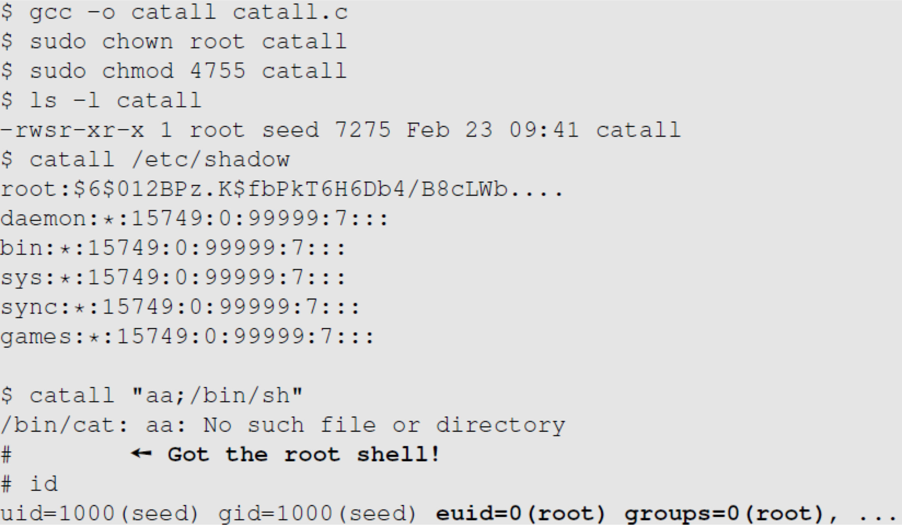
Invoking Programs : Unsafe Approach ( Continued)
Problem: Some part of the data becomes code (command name)
We can get a root shell with this input
Notes:
Notice catall program is a set UID program, and catall is owned by root, so when the catall root-owned program (ran by a user with x privileges) calls another program, it is calling it as root (euid= 0)
So note: if a set EUID program is called, euid will be effective for all subsequent programs CALLED FROM THAT PROGRAM!
Special note: see next slide, Ubuntu has a /bin/sh security parameter in place.

Slide 38
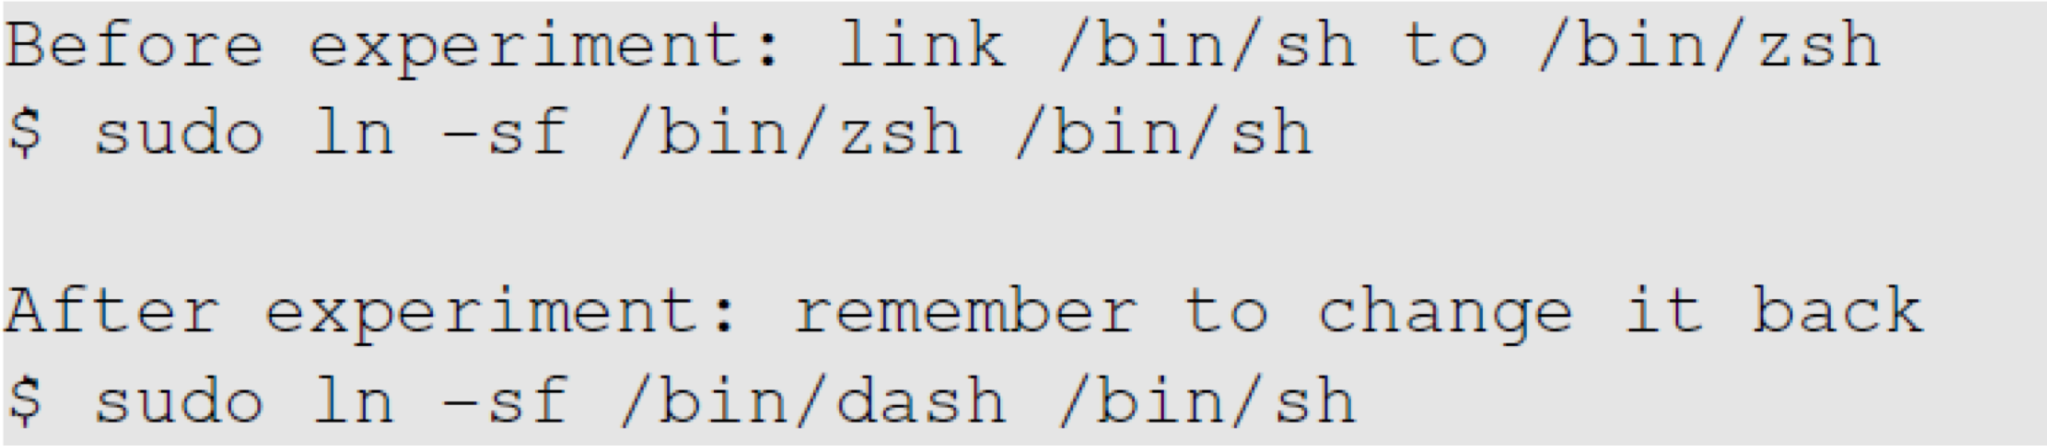
A Note
In Ubuntu 16.04, /bin/sh points to /bin/dash, which has a countermeasure
It drops privilege when it is executed inside a set-uid process
Therefore, we will only get a normal shell in the attack on the previous slide
Do the following to remove the countermeasure

Slide 39
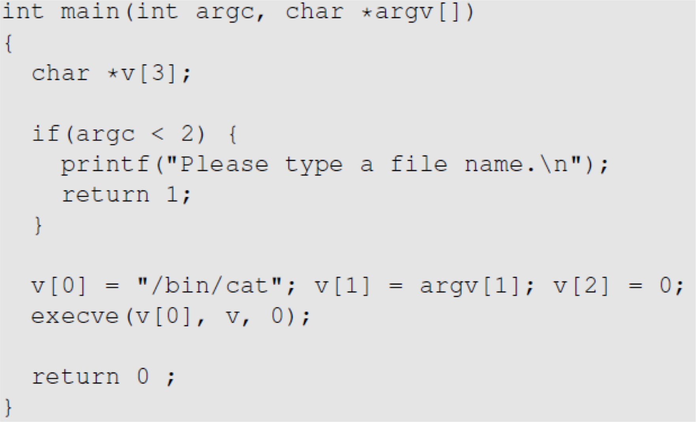
Invoking Programs Safely: using execve()
execve(v[0], v, 0)
Command name is provided here (by the program)
Input data are provided here (can be by user)
Why is it safe?
Code (command name) and data are clearly separated; there is no way for the user data to become code
Notes:
Execve() allows us to separate code and data (user input) in different variables.
execve() does not call shell program, rather it executes the command (code) right inside of the current program (process).

Slide 40
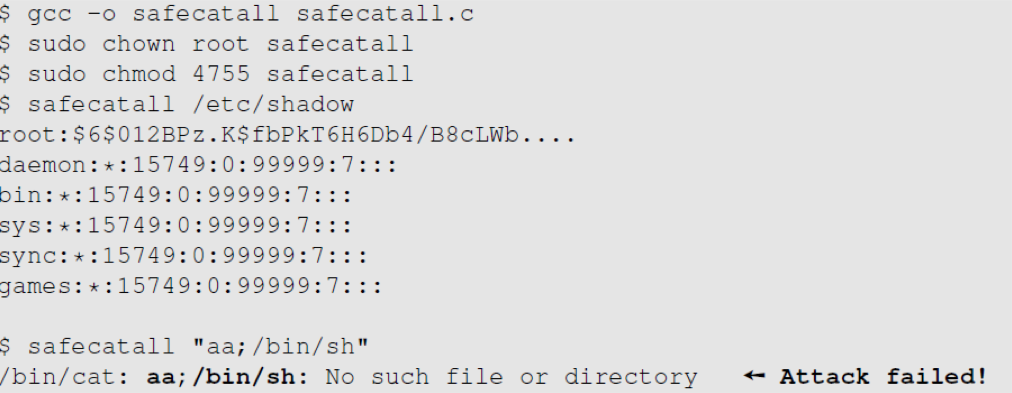
Invoking Programs Safely ( Continued)
The data are still treated as data, not code
Notes:
Treating entire string passed in by user as data, not as code.

Slide 41
Additional Consideration
Some functions in the exec() family behave similarly to execve(), but may not be safe
execlp(), execvp() and execvpe() duplicate the actions of the shell. These functions can be attacked using the PATH Environment Variable
Notes:
Remember PATH Environment Variables are an attack surface (vector)

Slide 42
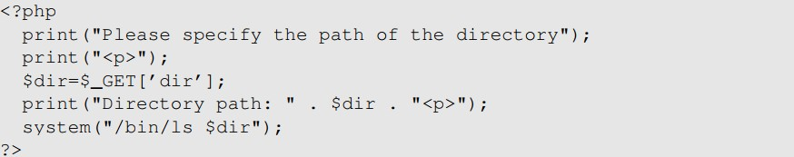
Invoking External Commands in Other Languages
Risk of invoking external commands is not limited to C programs
We should avoid problems similar to those caused by the system() functions
Examples:
Perl: open() function can run commands, but it does so through a shell
PHP: system() function
Attack:
http://localhost/list.php?dir=.;date
Command executed on server : “/bin/ls .;date”
Notes:
Of course attacker can do a lot more than run date command

Slide 43
Principle of Isolation
Principle: Don’t mix code and data.
Attacks due to violation of this principle :
system() code execution
Cross Site Scripting – More Information in Chapter 10
SQL injection - More Information in Chapter 11
Buffer Overflow attacks - More Information in Chapter 4

Slide 44
Principle of Least Privilege
A privileged program should be given the power which is required to perform it’s tasks.
Disable the privileges (temporarily or permanently) when a privileged program doesn’t need those.
In Linux, seteuid() and setuid() can be used to disable/discard privileges.
Different OSes have different ways to do that.
Notes:
Remember: seteuid() sets only euid.
Setuid() sets both euid and ruid.

Slide 45
Summary
The need for privileged programs
How the Set-UID mechanism works
Security flaws in privileged Set-UID programs
Attack surface
How to improve the security of privileged programs
Notes:
Goal: make sure to carefully add/remove privileges only when needed and never mix code with data.

